Slide 1




AI VS AI
PROJECT

Slide 2

TEAM MEMBERS
THANAA KHAIRY SAYED 20210247
Jawaher Ibrahim Ali 20210258
Rodina YAHIA MOHAMED 20210344
MONA MOHAMED ABDEL AZI 20210967
OMAR MOHAMED OMAR 20210624
ABDEL RAHMAN KHALED 20210499
SUPERVISED BY
DR.MOHAMMED EL-SAID

Slide 3


TABLE OF CONTENTS
Abstract
Motivation & Problem Significance
Problem Definition
Project Objectives & Scope
System Architecture
Image Generation Module
Image Detection Module
System Features
UI Preview
Challenges & Solutions
Future Work
Conclusion
01
02
03
04
05
06
07
08
09
10
11
12

Slide 4


1-ABSTRACT
"AI VS AI" is a web-based system that provides two core services:
AI-generated human face creation based on textual descriptions.
Detection of whether a given image was created using AI or not.

Slide 5

2- MOTIVATION & PROBLEM SIGNIFICANCE
The rapid advancement of generative AI has blurred the line between real and fake images, creating serious risks in areas like journalism, digital identity, and public trust in media.
Our Solution: Our system addresses this issue by enabling users to both detect AI-generated images and generate AI images responsibly, promoting transparency and ethical use of AI

Slide 6
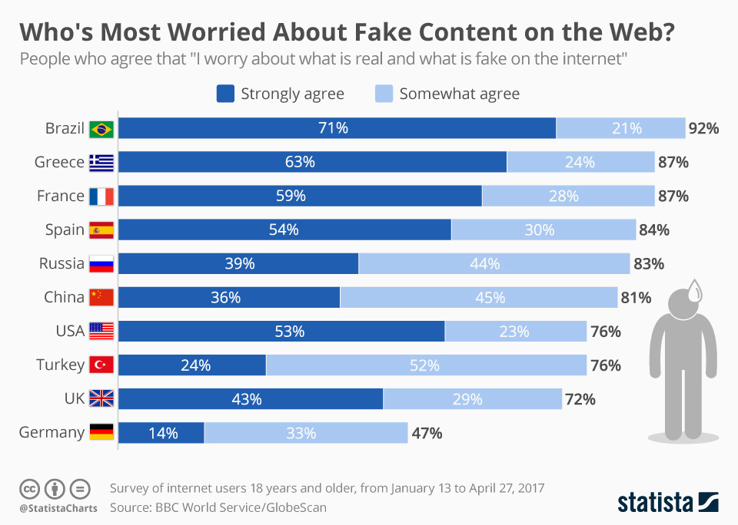
RISING GLOBAL WORRIES ABOUT DISTINGUISHING REAL FROM FAKE CONTENT ON THE INTERNET

Slide 7

ETHICAL CONSIDERATIONS
WITH THE RISE OF GENERATIVE AI, THERE IS A GROWING RISK OF MISUSE — ESPECIALLY IN CREATING DEEPFAKES THAT CAN SPREAD MISINFORMATION, HARM REPUTATIONS, OR VIOLATE PRIVACY.
OUR SYSTEM ACKNOWLEDGES THESE RISKS AND PROMOTES THE RESPONSIBLE USE OF AI BY:
PROVIDING TOOLS TO DETECT AI-GENERATED IMAGES, HELPING USERS VERIFY CONTENT AUTHENTICITY.
ENSURING TRANSPARENCY IN HOW IMAGES ARE GENERATED AND CLASSIFIED.

Slide 8
3- PROBLEM DEFINITION
There is a growing inability to distinguish AI-generated images from real ones, especially human faces. This increases misinformation and erodes trust in digital content. We aim to offer a reliable solution to detect and generate AI images with clarity.

Slide 9


4- PROJECT OBJECTIVES & SCOPE
PROVIDE A TOOL TO GENERATE REALISTIC HUMAN FACES USING AI FROM TEXT PROMPTS.
ENABLE ACCURATE DETECTION OF AI-GENERATED IMAGES.
TARGET USERS INCLUDE JOURNALISTS, EDUCATORS, CONTENT CREATORS, AND RESEARCHERS
THE PROJECT IS LIMITED TO FACIAL IMAGE GENERATION AND DETECTION ONLY

Slide 10
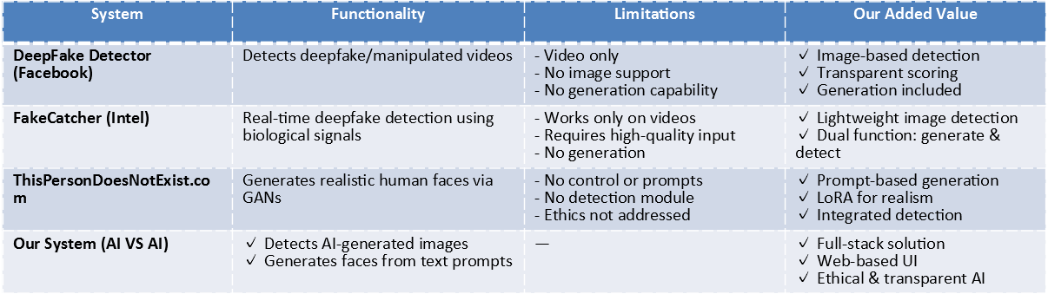
RELATED WORK / LITERATURE REVIEW
COMPARATIVE ANALYSIS

Slide 11

5. SYSTEM ARCHITECTURE
THE SYSTEM IS BUILT USING A MODULAR ARCHITECTURE:
Two main modules:
Image Generation & Image Detection
BACKEND
FRONTEND
Pretrained and fine-tuned models are integrated via APIs.
Python (Flask)
Angular

Slide 12



6. IMAGE GENERATION MODULE
THIS MODULE USES STABLE DIFFUSION V1.5, FINE-TUNED WITH LORA ON THE FFHQ DATASET, TO CREATE HIGH-QUALITY, REALISTIC HUMAN FACES BASED ON USER-PROVIDED DESCRIPTIONS.

Slide 13
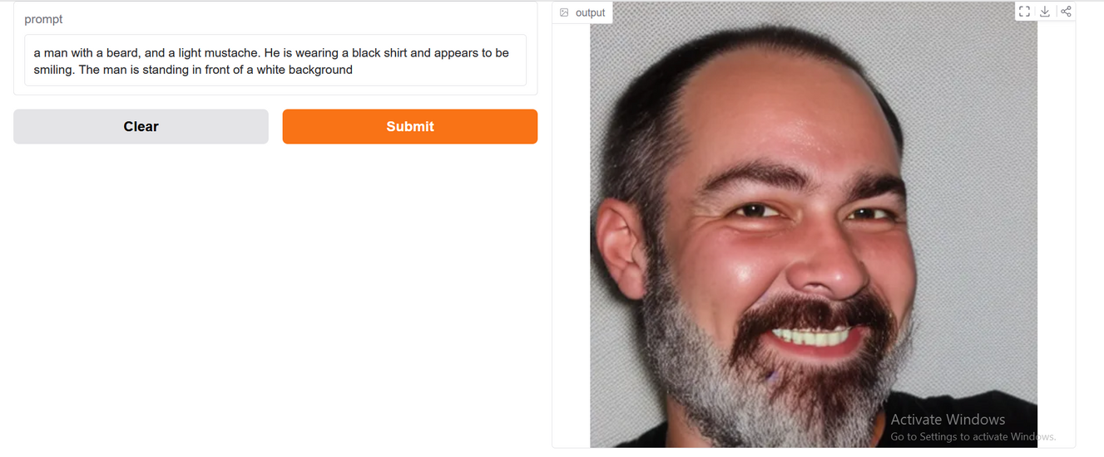
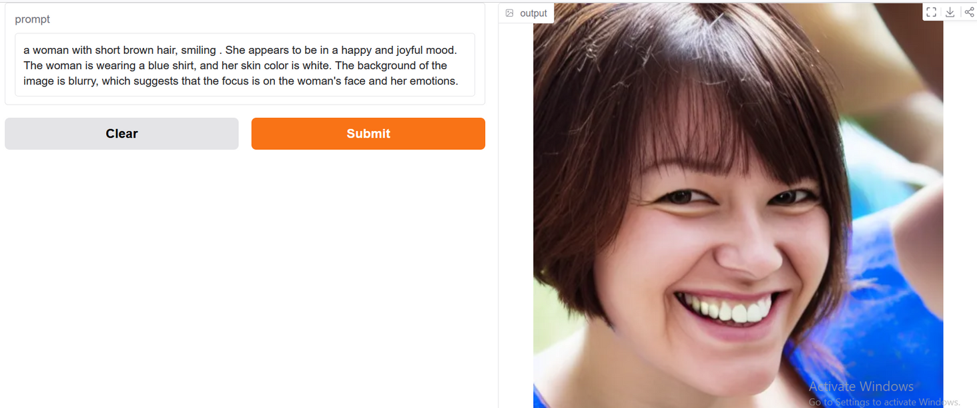

IMAGE GENERATION RESULT
FINE-TUNED WITH LORA ON THE FFHQ DATASET

Slide 14
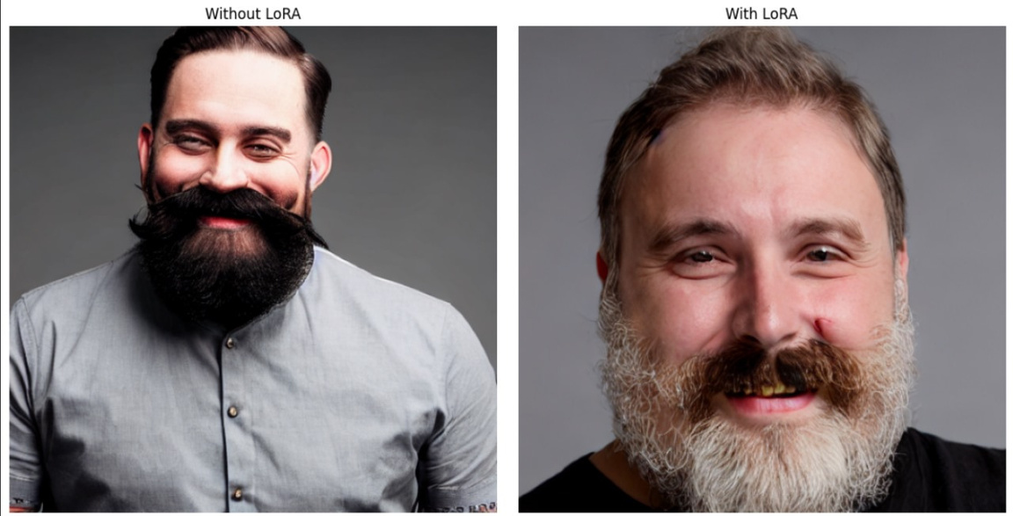
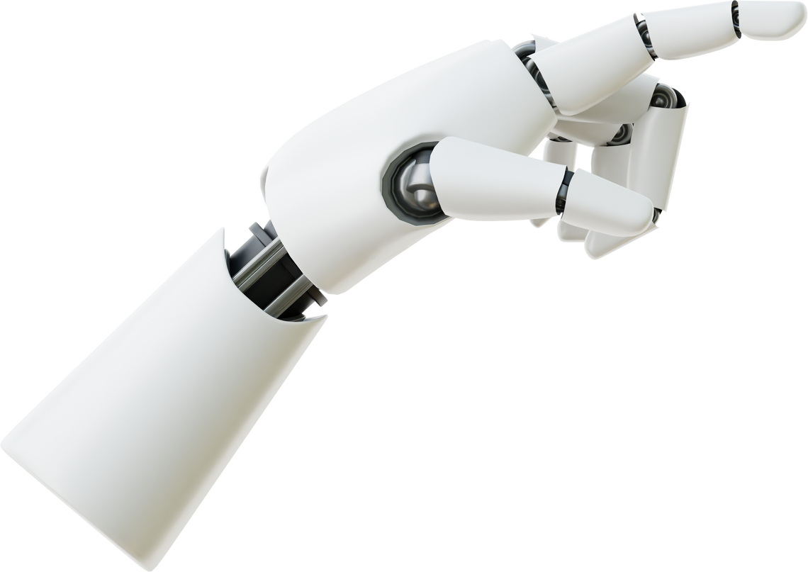
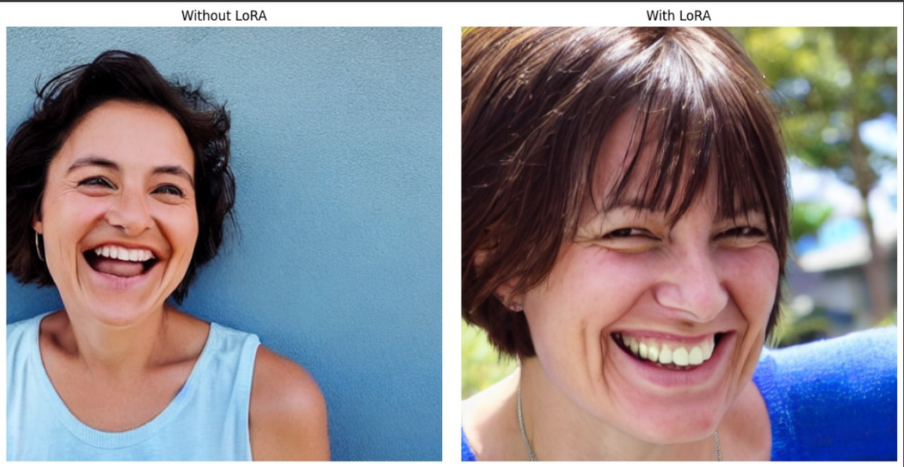
IMAGE GENERATION RESULT
BEFORE AND AFTER LORA FINE TUNED

Slide 15
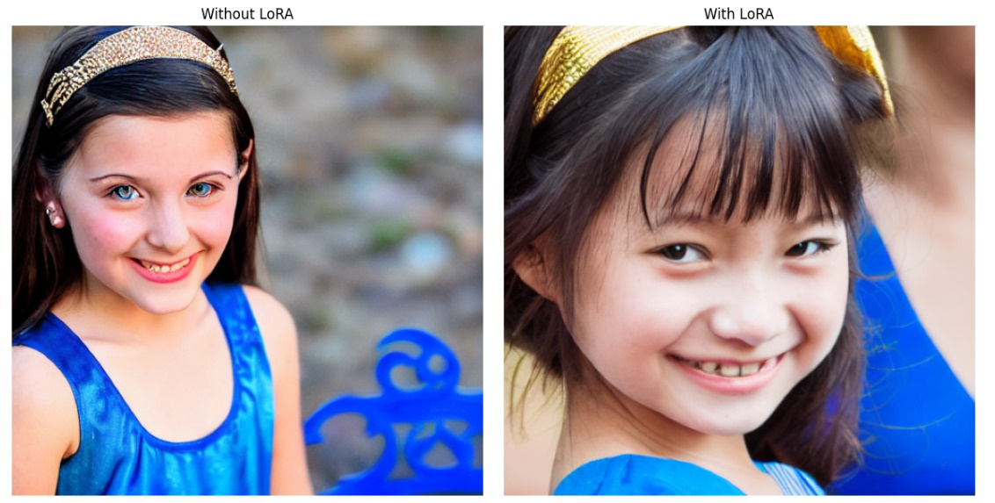
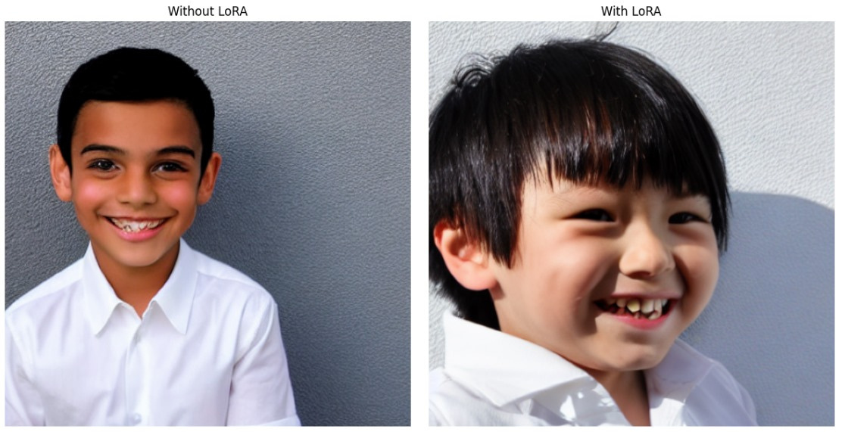
IMAGE GENERATION RESULT
BEFORE AND AFTER LORA FINE TUNED

Slide 16
COMPARISON BETWEEN
IMAGES BEFORE AND AFTER LORA FINE-TUNING
Feature | Without LoRA (Before Fine-Tuning) | With LoRA (After Fine-Tuning)
Facial Realism | Faces appear more artificial or stylized | Faces appear more realistic and natural
Texture Details | Skin texture and hair details are less defined | Clearer skin texture, more realistic hair and beard
Facial Hair (Men) | Beard/mustache looks more uniform and synthetic | Beard/mustache appears more varied and natural
Lighting and Shadows | Less dynamic lighting; sometimes flat | Improved lighting and shadow contrast
Expression Authenticity | Smiles and expressions look slightly forced or stiff | More natural, genuine-looking expressions
Background Integration | Background sometimes looks artificial or inconsistent | Better background blending and realistic outdoor lighting
Color Tone and Balance | Skin tones and colors can be off or less vibrant | More natural skin tones and balanced color representation
Overall Realism | Looks like an AI-generated image | Strong resemblance to real human photographs

Slide 17
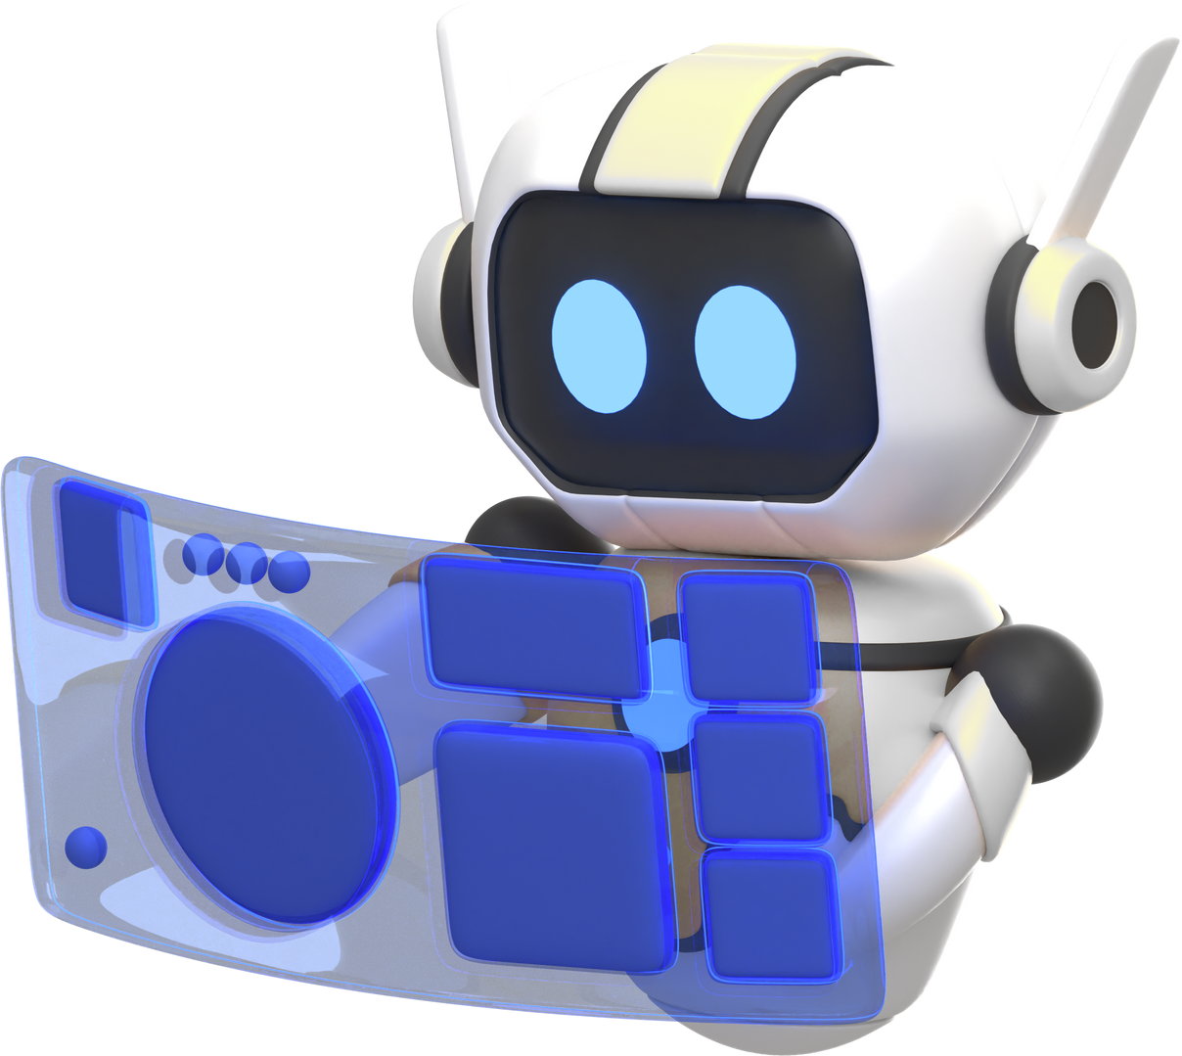
7. IMAGE DETECTION MODULE
BUILT WITH A CNN-BASED CLASSIFIER (EFFICIENTNET-B6), THIS MODULE IS TRAINED ON DATASETS OF REAL AND FAKE FACES TO DETECT AI-GENERATED IMAGES WITH HIGH ACCURACY AND RELIABILITY.

Slide 18
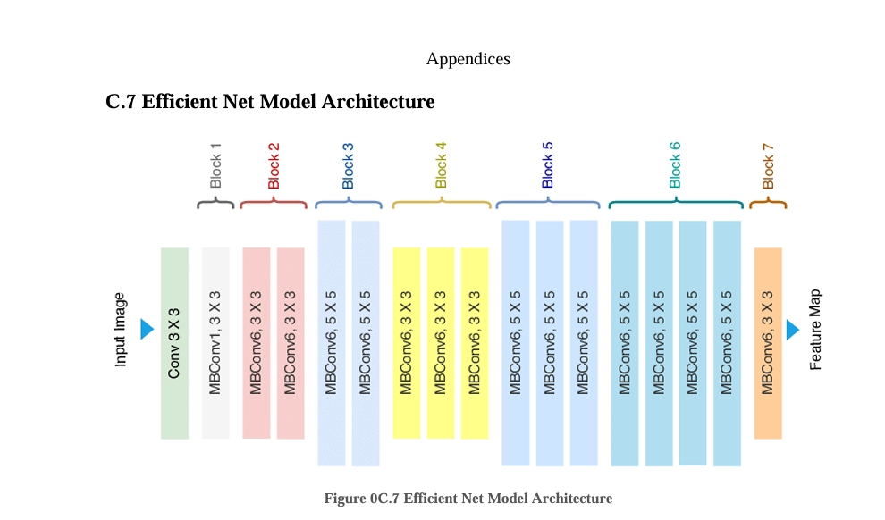

IMAGE DETECTION MODULE

Slide 19
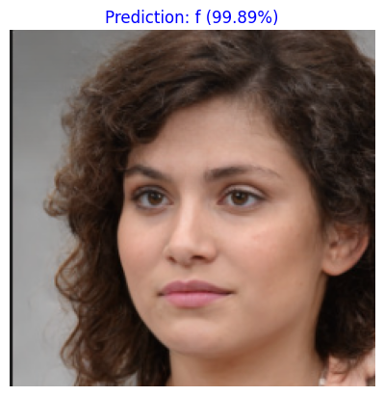

IMAGE DETECTION RESULT
F 99.89% GENERATED BY AI SO IT'S FAKE

Slide 20
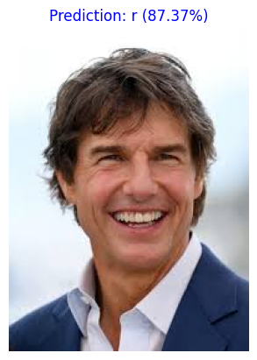

IMAGE DETECTION RESULT
R 87.37% REAL IMAGE SO IT'S REAL

Slide 21

8. SYSTEM FEATURES
REALISTIC FACE GENERATION FROM TEXT
DETECTION OF AI-GENERATED FACES
USER-FRIENDLY INTERFACE
ADMIN PANEL FOR DATABASE AND MODEL CONTROL
SECURE LOGIN/REGISTER FUNCTIONALITY

Slide 22


HOW TO USE THE SYSTEM: GENERATE AND VERIFY AN IMAGE
PHASE 2– AI DETECTION
PHASE 1 – AI FACE GENERATIONS
STEP 1–UPLOAD IMAGE
STEP 1 – USER PROMET
2-EFFICIENTNET-B6 ANALYZES THE IMAGE AND PREDICTS
IF GENERATED BY AI (FACE GENERATION MODULE) PREDICTION: AI-GENERATED
IF REAL (UPLOADED FROM A CAMERA) PREDICTION: REAL
2-LORA FINE-TUNED STABLE DIFFUSION GENERATES A REALISTIC IMAGE MATCHING THE PROMPT

Slide 23

REAL-WORLD APPLICATIONS
JOURNALISM (DETECT FAKE NEWS)
SOCIAL MEDIA MODERATION
AI ETHICS EDUCATION
CREATIVE CONTENT GENERATION

Slide 24
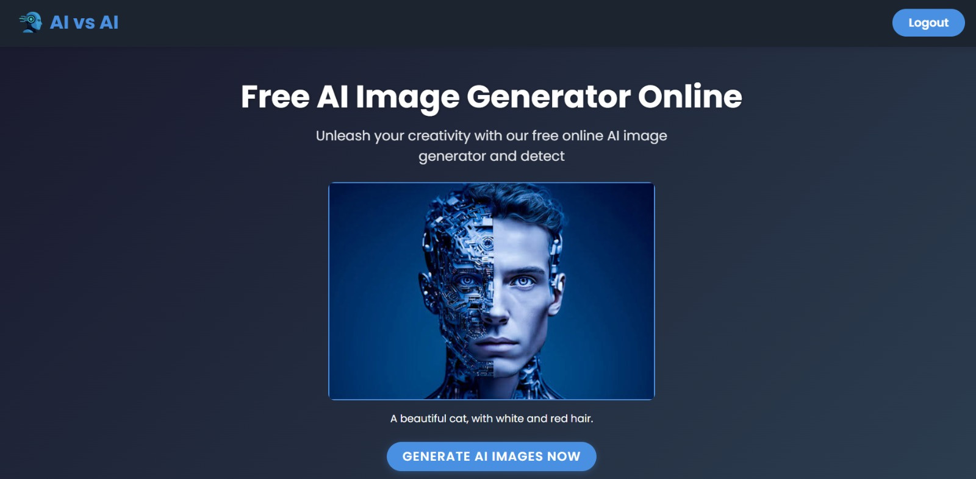
9. UI PREVIEW

Slide 25
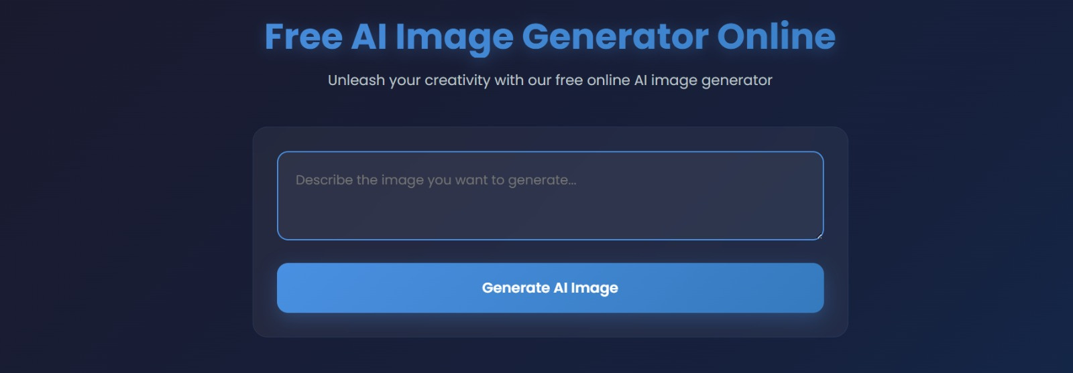
USER INTERFACE

Slide 26

USER INTERFACE

Slide 27

10.CHALLENGES & SOLUTIONS
CHALLENGE
FINE-TUNING LARGE MODELS WITH LIMITED RESOURCES
SOLUTION
USED LORA FOR LIGHTWEIGHT FINE-TUNING.
CHALLENGE
BALANCING ACCURACY AND SPEED IN DETECTION
SOLUTION
CHOSE EFFICIENTNET-B6 FOR OPTIMAL PERFORMANCE.
CHALLENGE
INTEGRATING AI MODELS WITH FRONTEND
SOLUTION
DESIGNED MODULAR APIS IN FLASK

Slide 28
11. FUTURE WORK
01
03
Extend detection to other AI-generated content types (e.g., videos, voice)
Develop a browser extension for real-time image verification.
02
04
Enhance multilingual prompt support.
Add watermarking to generated images

Slide 29

12. CONCLUSION
"AI VS A" bridges the gap between the power of generative AI and the need for content authenticity. It offers practical tools for responsible AI use, serving both creators and verifiers in the digital world.

Slide 30


THANK YOU!

